Slide 1

“A SHORT RANGE RADAR SYSTEM USING 8051 MICROCONTROLLER ”
Under the Guidance of :
Prof.V.M.SARDESHMUKH
PROJECT BY:
Atul Dharne etTa006
Nikhil sonje ETta008
SankeT Mallawat ETta025

Slide 2
OVERVIEW
Introduction
Block diagram
Description of components
System architecture
PCB layout & 3D view
Implementation Details
Algorithm
Advantages, Disadvantages
Applications
Future scope
Conclusion
References
Simulation Result

Slide 3
INTRODUCTION
The term radar was coined in 1940 by the United States Navy as an acronym for Radio Detection And Ranging. Radar is an object-detection system that uses radio waves to determine the range, angle, or velocity of objects. It can be used to detect aircraft, ships, spacecraft, guided missiles motor vehicles, weather information, and terrain information. A radar system consists of a transmitter producing electromagnetic waves in the radio or microwaves domain, a transmitting antenna, a receiving antenna. Radio waves (pulsed or continuous) from the transmitter reflect of the object and return to the receiver, giving information about the object's location and speed.

Slide 4
The main components in any Ultrasonic radar are the Ultrasonic Sensors. Ultrasonic sensors work on a principle similar to RADAR. Ultrasonic sensors generate high frequency sound waves and evaluate the echo which is received back by the sensor. Sensors calculate the time interval between sending the signal and receiving the echo to determine the distance to an object.
Generally, the distance can be measured using pulse echo method. The ultrasonic module transmits a signal to the object, then receives echo signal from the object and produces output signal whose time period is proportional to the distance of the object. The mechanism of the ultra sonic sensor is similar to the RADAR (Radio Detection and Ranging).

Slide 5
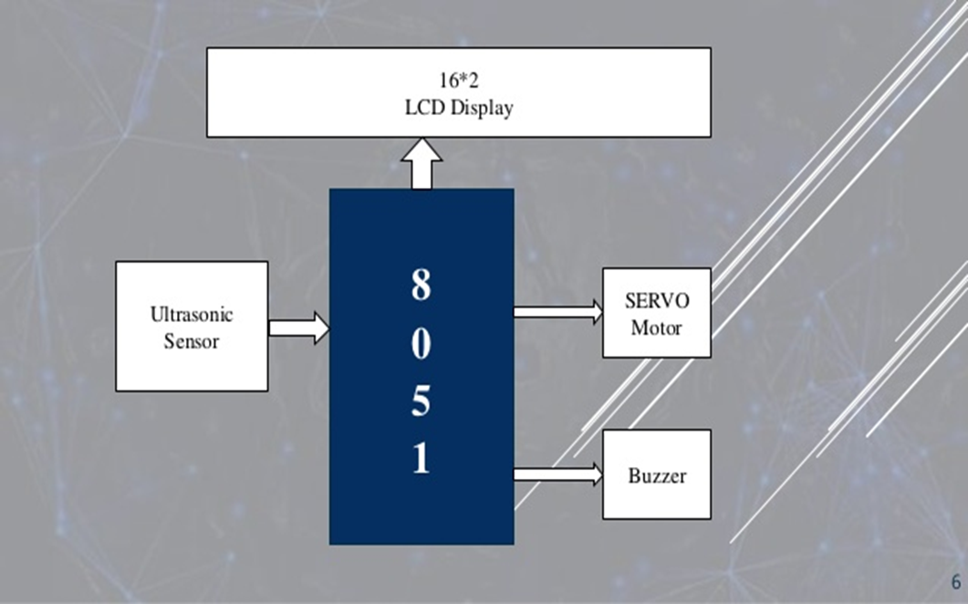
Block Diagram

Slide 6
Description
It consists of 5 major parts
1. 8051 Microcontroller
2. Ultrasonic Sensor
3. Servo Motor.
4. LCD display
5. Buzzer

Slide 7
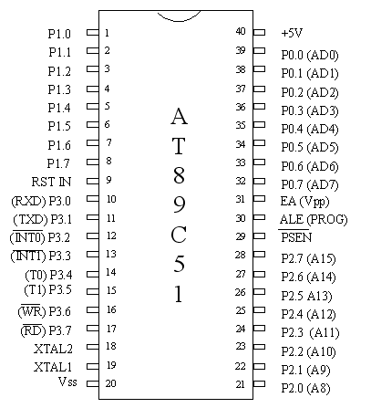
Microcontroller
Model AT89C51.
Operating Voltage is 5v.
8 Bit Microcontroller.
It Has 256 Bytes Ram and 8kb Rom with 12Mhz Frequency.

Slide 8
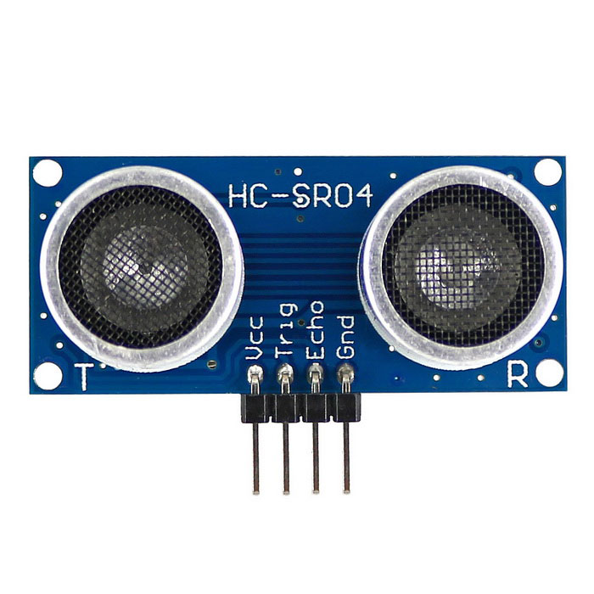
Ultrasonic Sensor
Model Number is HC-SR04.
Operating Voltage is 5V.
Its Range From 2cm to 400cm and 40HZ Frequency.
No. Of Pins 4.

Slide 9
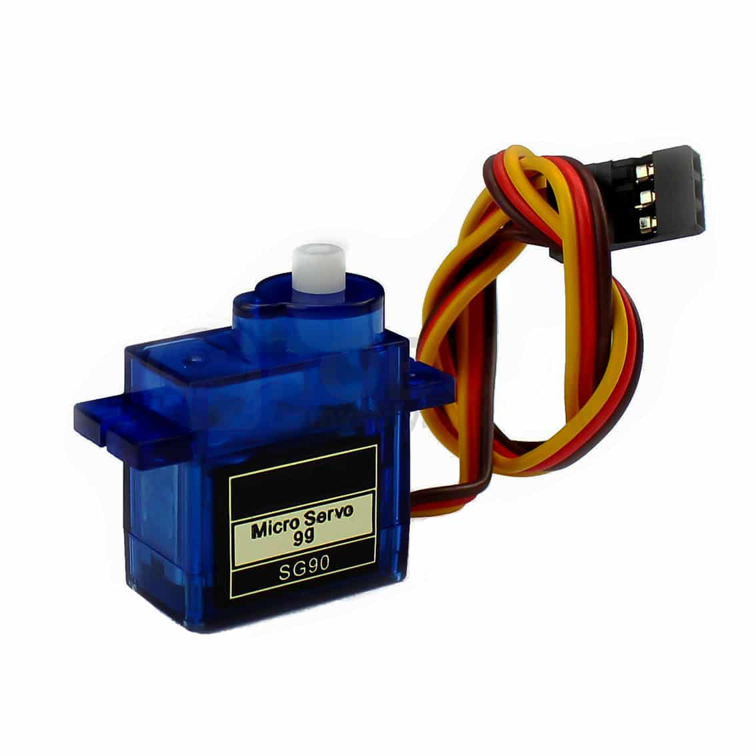
Servo Motor
A servomotor is a rotary actuator or linear actuator that allows for precise control of angular or linear position, velocity and acceleration.
Operating Voltage is 12V.
No. of pins 3.

Slide 10
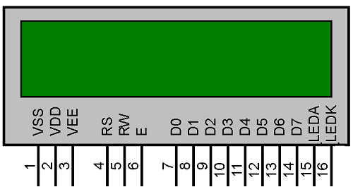
LCD display
16*2 Liquid Crystal Display [LCD]
Operating Voltage is 5V
No. of Pins 16 Pins
VCC, GND, RS, EN, R/Ŵ, 8 Data Pins, 2 back light LED,POT

Slide 11
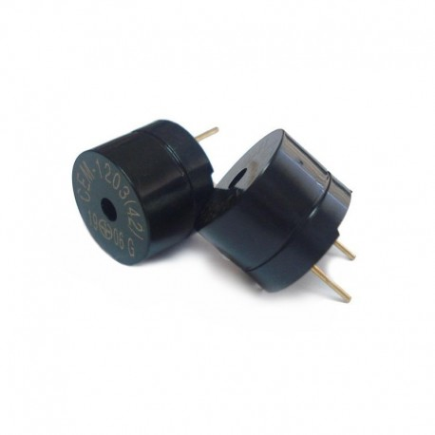
Buzzer
A buzzer or beeper is an audio signaling device.
It Consist of 2 pin VCC and GND.
Operating Voltage is 5v.

Slide 12
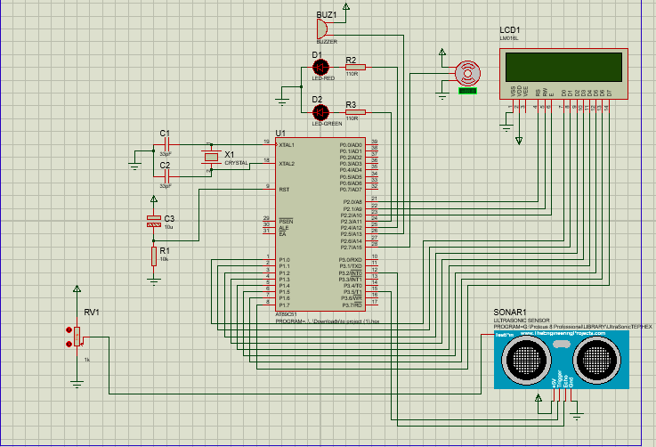
System Architecture
The System Architecture of the Short Range Radar System .
For simulation we use proteus software and for coding we use keil v.3.

Slide 13
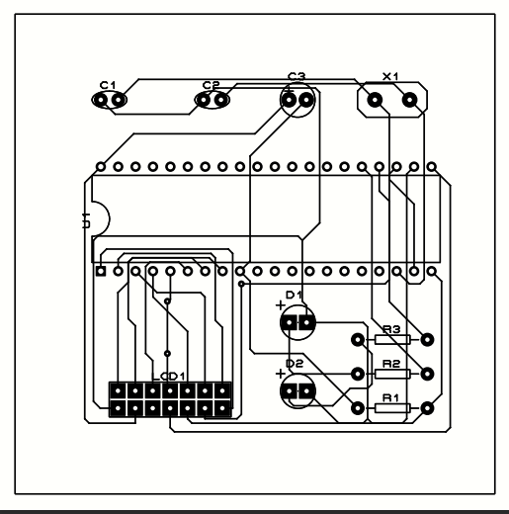
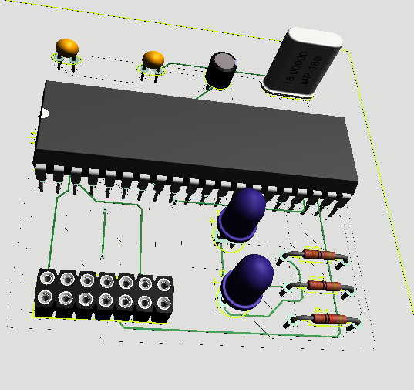
PCB Layout & 3D view

Slide 14
Implementation Details
1. The HC-SR04 module has ultrasonic transmitter, receiver and control circuit on a single board. The module has only 4 pins, Vcc, Gnd, Trig and Echo.
2. When a pulse of 10sec or more is given to the Trig pin, 8 pulses of 40 kHz are generated. After this, the Echo pin is made high by the control circuit in the module.
3. Echo pin remains high till it gets echo signal of the transmitted pulses back.

Slide 15
4.The time for which the echo pin remains high, i.e. the width of the Echo pin gives the time taken for generated ultrasonic sound to travel towards the object and return.
5. Using this time and the speed of sound in air, we can add the distance of the object using a simple formula for distance using speed and time.
6.The distance displayed on LCD and the LED and Buzzer was ring as the obstacles come closer to the Range.

Slide 16
Algorithm
The algorithm for finding the distance uses the following algorithm:
Initialize the LCD.
Initialize the timer registers
Call get range subroutine.
Get range:
Display LCD
Obstacle detected
Led & Buzzer on

Slide 17
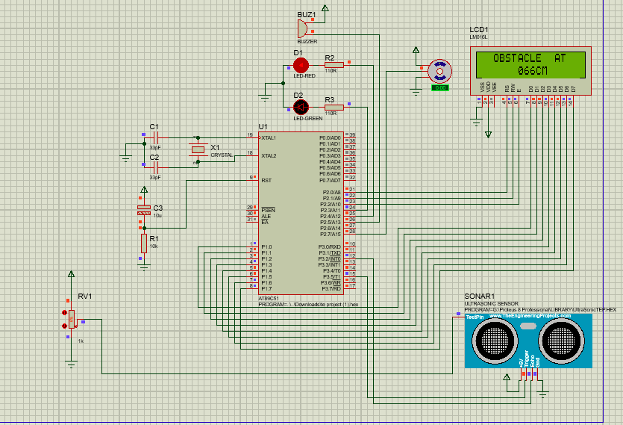
Simulation Result
When The Obstacle Was Detected Under The 100cm Range The Red Led Glow And The Buzzer Was Start Ringing

Slide 18
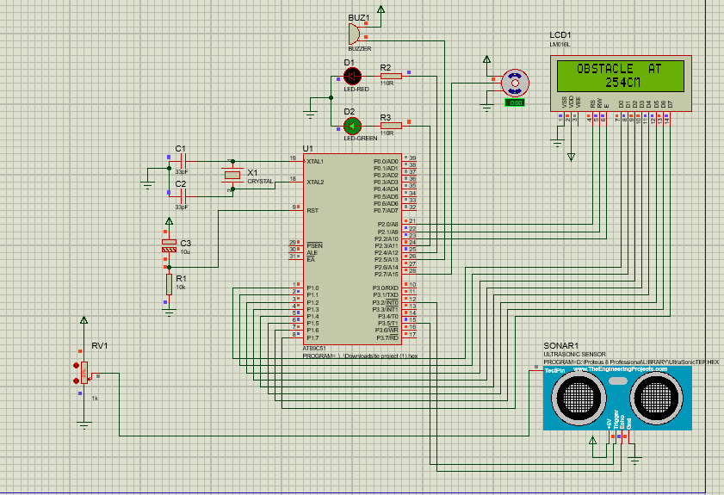
When The Obstacle Was Detected Beyond The 100cm Range The Green Led Glow .

Slide 19
ADVANTAGES
It can work in any adverse conditions.
It has higher sensing distance.
Ultrasonic sensors can easily interface with Microcontroller or any type of controller.
These sensors are easy to use, not dangerous during
Operation for nearby objects, person, equipment or material

Slide 20
DISADVANTAGES
When These Sensors are used for inspection purpose then
These should be water resistive otherwise they could be damaged.
It Has more difficulties in reading reflections from soft, curved, thin and small objects.
Captured Image

Slide 21
APPLICATIONS:
In air defense it is used for target detection, target recognition
Identifying enemy locations in map.
The Air Surveillance RADAR is used to detect and display the aircraft’s position in the airport terminals.
RADAR speed meters are used by traffic police for enforcing speed limit.

Slide 22
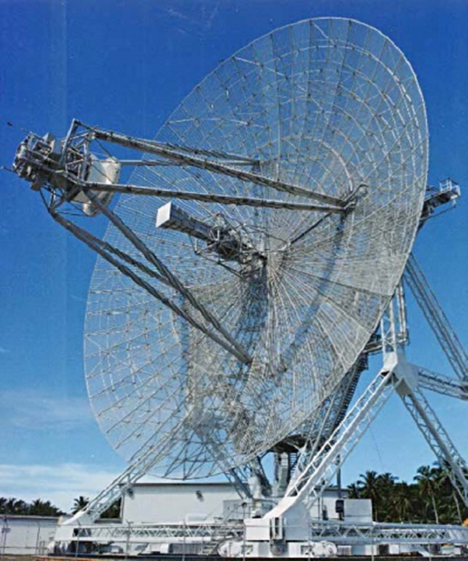
FUTURE SCOPE
A GSM can be used to send SMS to concerned person about detects object, distance.
A camera can also be used to view the live video .

Slide 23
CONCLUSION
In this project, Interfacing of Ultrasonic module HC-SR04 with 8051 Microcontroller using Keil C software was performed successfully and using the mechanism of the ultrasonic sensor
The Object distance up to 4 meters was measured and this system (HC SR04 ultrasonic sensor) was not able to measure longer distances. hence, for more range, we can try replacing the sensor module.
Designed project can able to detect the object and also gives audio signaling if any object is detected within the 30cm range.

Slide 24
Refrences
Frequency-agile non-coherent ultrasound radar for collection of micro-Doppler signatures, By: Balleri, K. Woodbridge, June 2011
Ultrasound System Considerations and their Impact on Front-End Components, By: Brunner Eberhard, May 2009
Space and frequency diversity for moving personnel spectrogram estimation By: P. Sammartino, J. Fortuny-Guash, June 2018
Radar System Using Arduino And Ultrasonic Sensors By Shreyes Mehta, Shashank Tiwari, June 2013

Slide 25
Thank you

